Slide 1

Registry Committee Monthly Update – November 2019
Marketing
Conferences
  Email Blast sent to Members not in Registry Nov 20
  350,000 web impressions campaign launched Sept 1 see slide 4
  Texas LTA has requested content to promote the Registry to its members
Total Locations⁽¹⁾⁽²⁾⁽³⁾ | Unique Companies
8023 | 2927
Includes UW Direct Offices
As of 11/25/2019
Includes REAs
New Section: Data Analytics
Sales Activities:
Active Opportunities: 10
  Lenders: 5
  Tech Providers/compliance service providers 2
  Strategic Partners 3
  In November 2019 we passed 8,000 locations
  Search results see slide 3
    Sep – Nov: 2,802 searches performed
Technology/Development
ALTA Registry web site redesign underway
ALTA Staff investigating E&O oversight process used by Underwriters
ALTA Staff creating a generic “eClosing/RON” capable definition
Committee Meetings
  Scope Expansion language development underway deadline Dec 6th, 2019
  Q1 20 Conf Call 01/08/2020
  Q2 20 F2F ALTA Springboard 3/8/2020

Slide 2
Searches of the Registry by Anonymous Users
Sep19th - Nov 19th, 2019

Slide 3
Search Results Comparisons

Slide 4
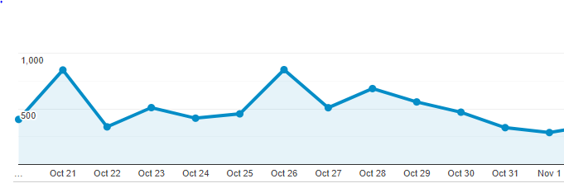
Web traffic from web impression campaign over ALTA ONE & MBA
8,614 visitors site visitors

Slide 5
Registry Committee Meetings
2019- 2020
Year | Q | Dates | Time | Format | Event | Location
2020 | Q1 | 01/08/2020 | 2:00 PM – 4:00 PM ET | CC | NA
2020 | Q2 | 03/09/2020* | 8:00 AM – 10:00 AM CT | CC+F2F | ALTA SPRINGBOARD | Denver, CO
2020 | Q3 | 07/13/2020 | 2:00 PM – 4:00 PM ET | CC | NA
2020 | Q4 | Oct TBD |  | CC+F2F | ALTA ONE | NYC
* Note new date and includes breakfast!

