Slide 1

Registry Committee Monthly Update – April 2020
Total Locations⁽¹⁾⁽²⁾⁽³⁾ | Unique Companies
8182 | 3053
Marketing:
  Attendance at industry conferences is currently on hold
Includes UW Direct Offices
As of 4/29/2020
Includes REAs
Sales Activities:
Active Opportunities: 11
  Lenders: 8
  Tech Providers 1
  Strategic Partners 1
  Govt Entities: 1
Technology
    Mapping Registry data to MISMO schema continues
    RON Icon Program initiated
Committee Meetings
  Q3 20 Conf Call: 2:00 PM – 4:00 PM ET 7/13/2020
  Q4 20 F2f/Conf Call @ ALTAONE October 2020

Slide 2
Board of Governors Approve
RON Icon Program
On April 17th the Board of Governors approved a proposal to expand the Registry dataset to include information relating to agents’ Remote Online Notary capabilities.
Programming started on April 27th and is schedule to be deployed as follows:
  ALTA Registry and Registry Management System development completed by 5/15
  ALTA Registry and Registry Management System testing and defect fixes completed by 5/19
  ALTA Registry and RMS production release on 5/20
Communication Plan
  Press Release to be issued 5/20
  Email blast to Agents in Registry to be sent w/b 5/21
  Email blast to ALTA universe of agents (not in Registry) w/b 6/1
  Direct marketing to lenders to begin 6/15 via telemarketing & web ad microtargeting

Slide 3
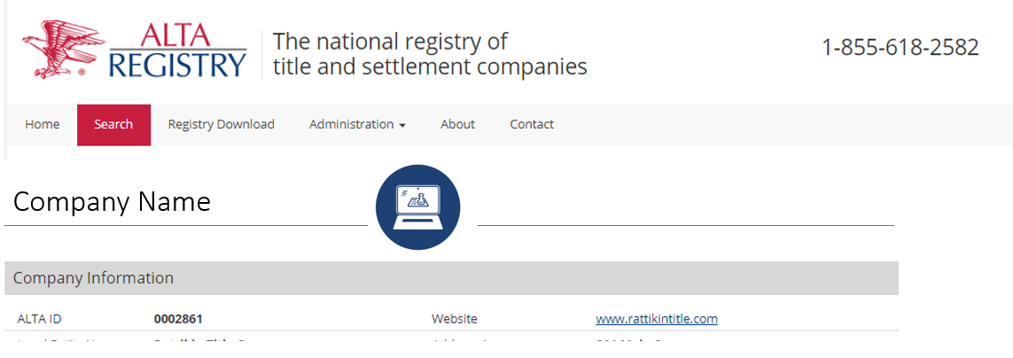
RON Icon deployment -
Individual Record Lender View

Slide 4
Registry Committee Meetings
2020
Year | Q | Dates | Time | Format | Event | Location
2020 | Q3 | 07/13/2020 | 2:00 PM – 4:00 PM ET | CC | NA
2020 | Q4 | Oct TBD |  | CC+F2F | ALTA ONE | NYC

